Slide 1
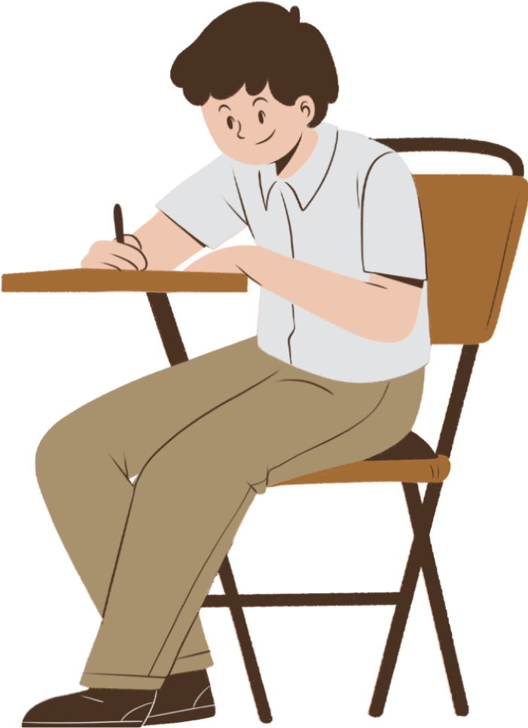

Gerunds or Infinitives?
A Grammar Presentation

Slide 2

Introduction
Welcome to today's lesson on the different uses of gerunds and infinitives in English. Sometimes it can be challenging to understand the different uses of these verb forms, but understanding them is essential for effective communication. In this presentation, we'll explore their various uses in different contexts. By the end of this lesson, you'll have a solid understanding of these grammar structures and how to use these forms correctly and confidently in your everyday conversations and writing.

Slide 3

Gerunds
(verb + -ing)

Slide 4
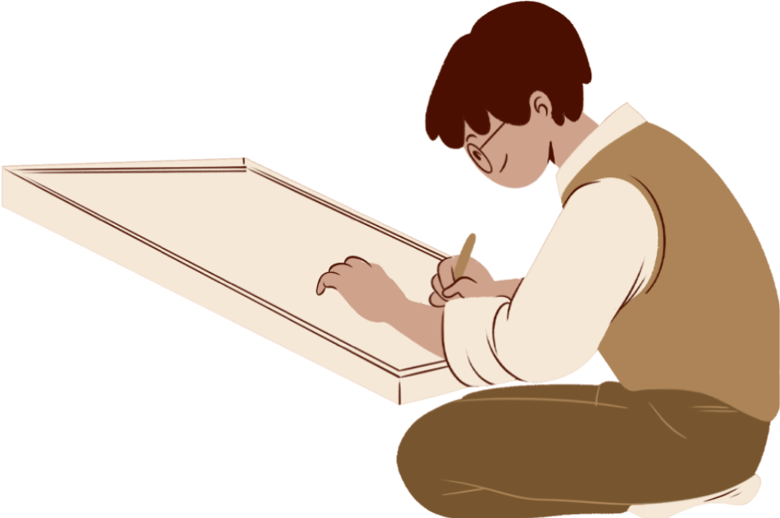
After prepositions and phrasal verbs
“I’m very good at drawing” (preposition)
“Olivia’s given up studying English” (phrasal verb)

Slide 5
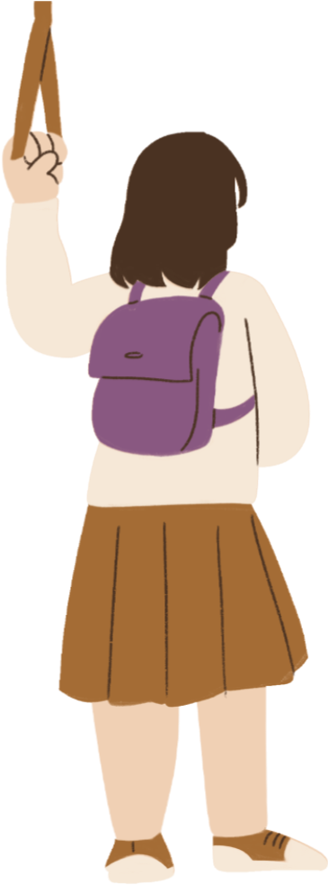

as the subject of a sentence
“Riding my bike is one of my favorite activities.”
“Taking the bus to school is more convenient than driving in rush hour traffic.”

Slide 6
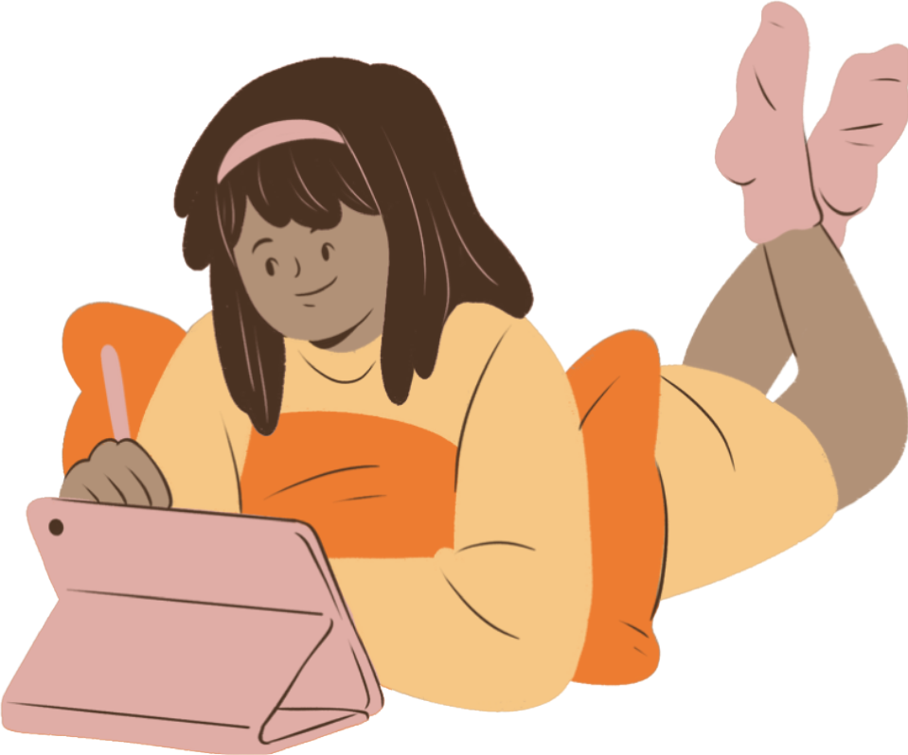
after some verbs
Common verbs which take the gerund include: admit, avoid, deny, dislike, enjoy, feel like, finish, hate, keep, like, love, mind, miss, practise, prefer, recommend, spend time, stop, suggest.
“I don’t mind getting up early”
“I hate not being on time for things”

Slide 7

The infinitive with to

Slide 8

to express a reason or purpose
“Claudia does exercise to have more energy”
“She is studying hard to pass all her tests”

Slide 9
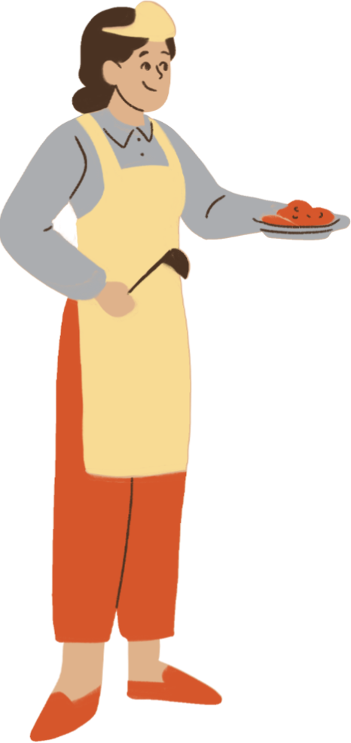
After adjectives
“This recipe is very easy to make”
“Be careful not to burn yourself when cooking”

Slide 10
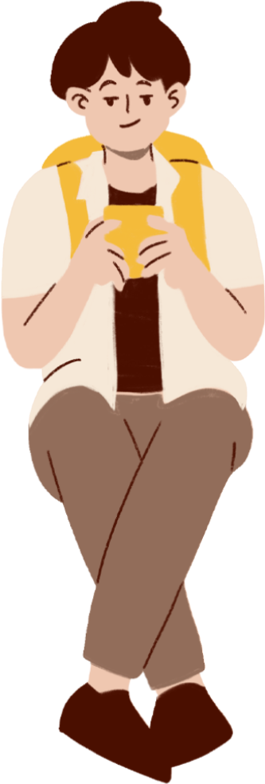
after some verbs
Common verbs which take the infinitive include: (can’t) afford, agree, decide, expect, forget, help, hope, learn, need, pretend, promise, refuse, remember, seem, try, want, would like. More verbs take the infinitive than the gerund.
“I can’t afford to buy a new phone now”

Slide 11
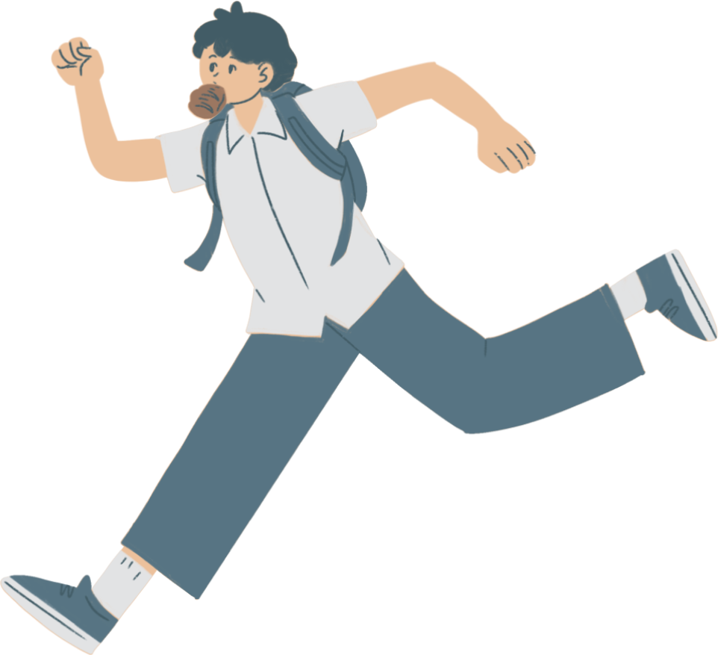
verb +person+infinitive with to
“I want you to do this now.”
“The teacher told him not to run.”
“Can you ask Olivia to come?”

Slide 12
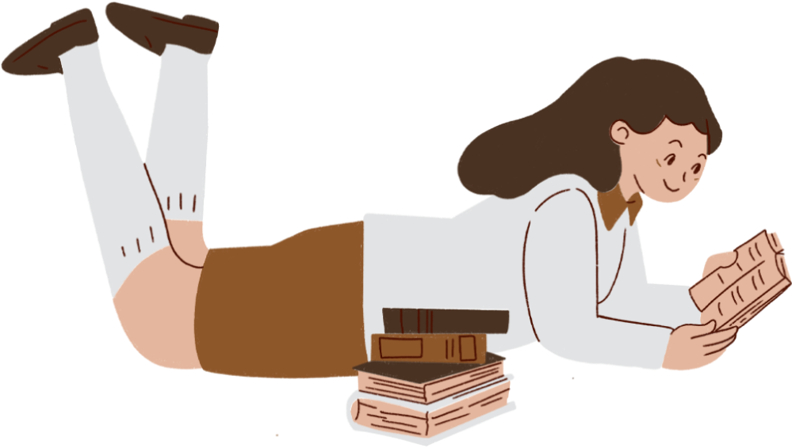
The infinitive without to

Slide 13
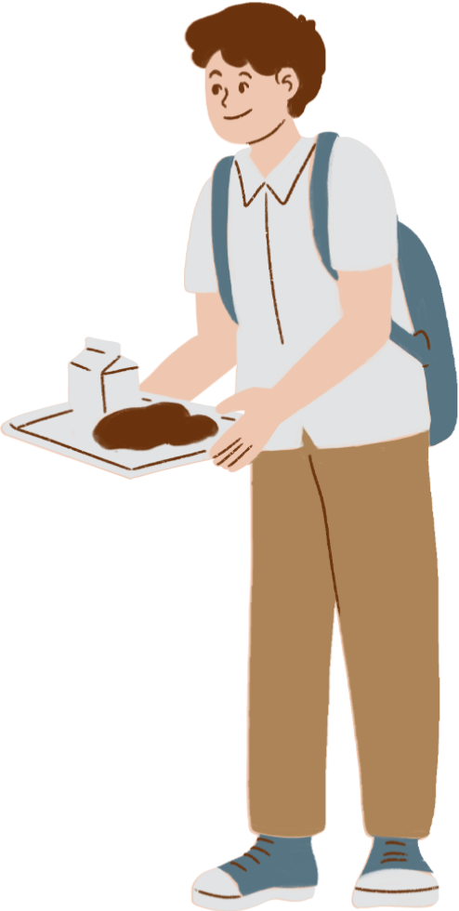
After modals and auxiliary verbs
“We must eat really fast to be on time for the test”
after make and let
“My parents didn’t let me go out last night”

Slide 14

start
common verbs that can take the infinitive or gerund with no difference in meaning
It started to rain/ raining.
begin
I began to take/ taking classes in 2015.
continue
We continued talking/ to talk.

Slide 15
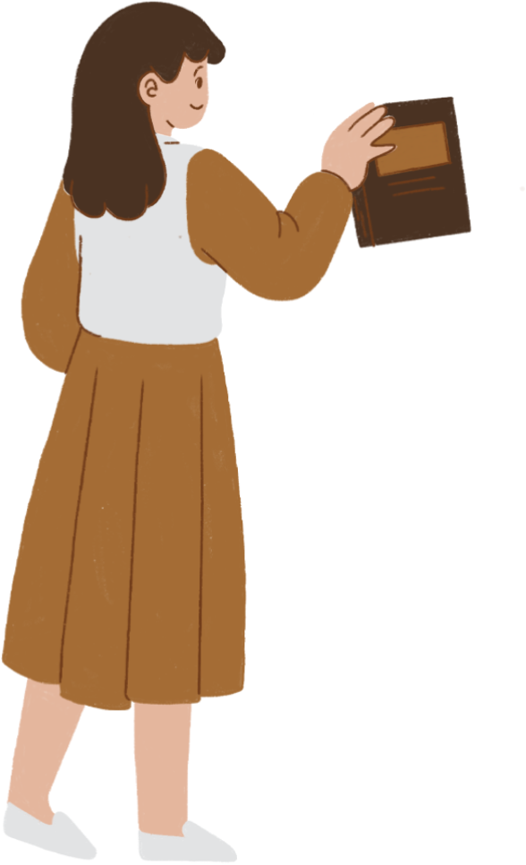
common verbs that can take the infinitive or gerund but the meaning is different
stop- try- Remember- forget
  “I’ve stopped taking the bus.
( I don’t take it anymore)”
  “I remember calling her” (having a memory of calling her)”
  “I stopped to take the bus. (stop an activity to do something else)”
  “I remembered to call her
(I didn’t forget to call her)”

Slide 16

Thanks!

Slide 17

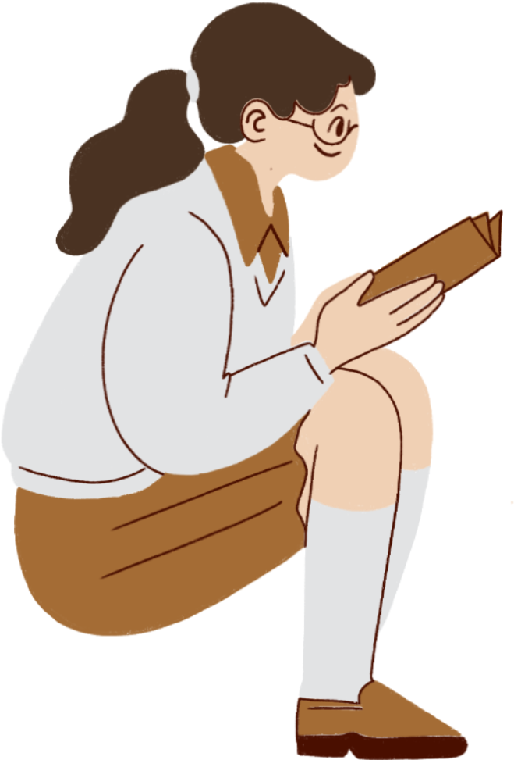

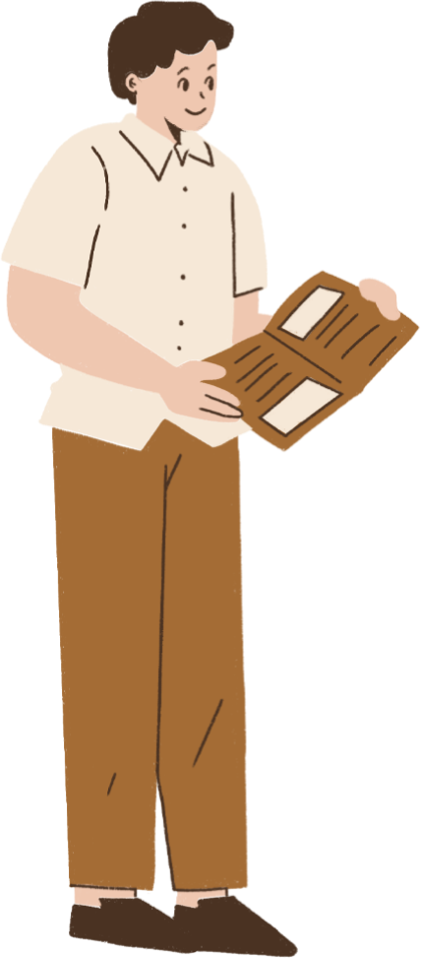
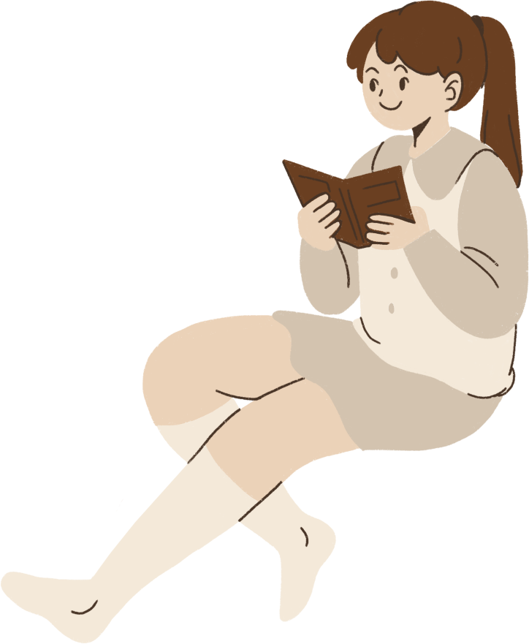

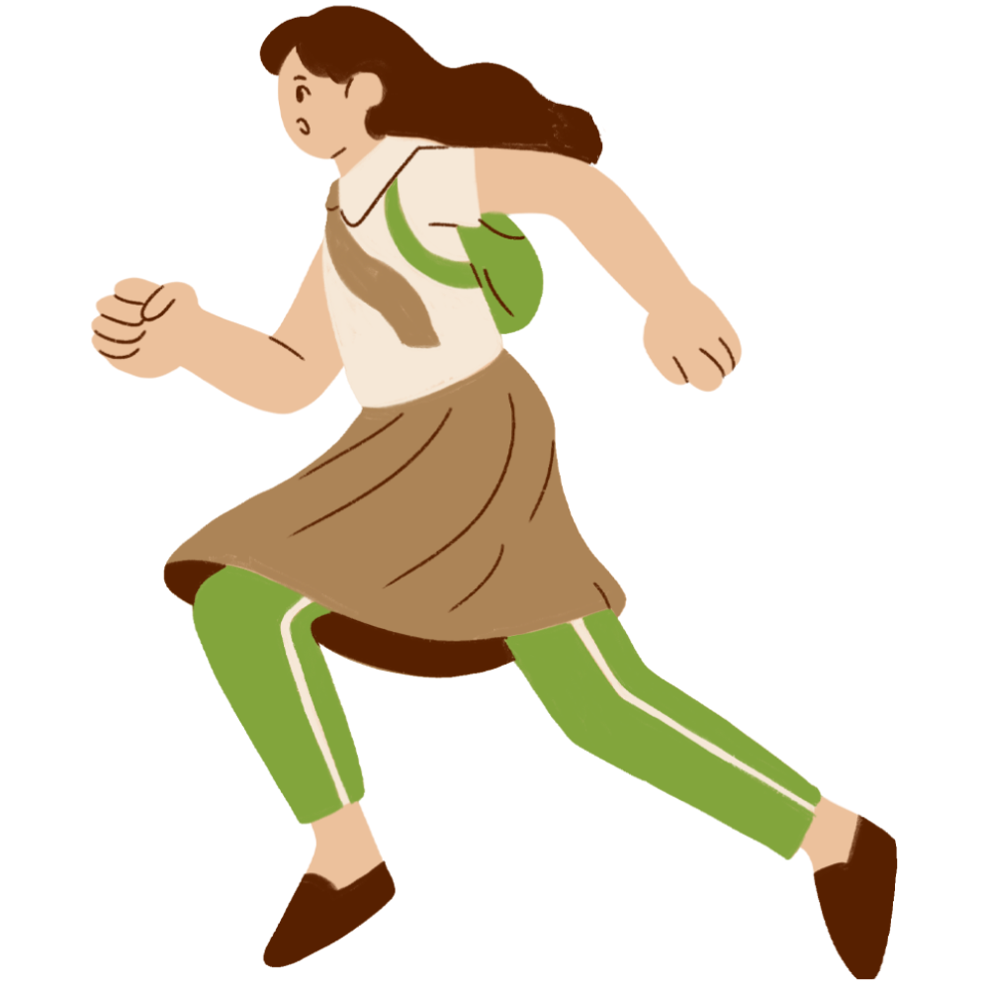
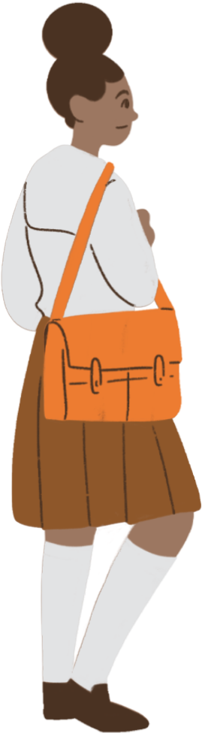
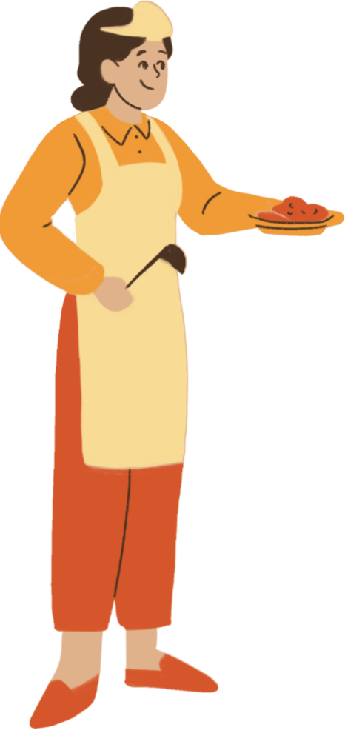


teacher resources page

